Slide 1
Everyone Is Not Like You: Knowledge Sharing and the Team Environment Dave Gosselin Director Environmental Studies University of Nebraska-Lincoln

Slide 2
Learning Outcomes
Upon completion of this activity, the participant will be able to:
Articulate their perspectives, assumptions, and strategies related to research and investigation
Identify similarities and differences of their perspectives, assumptions, and strategies with those of others in the workshop.
Employ a structured dialogue approach to facilitate group interactions

Slide 3
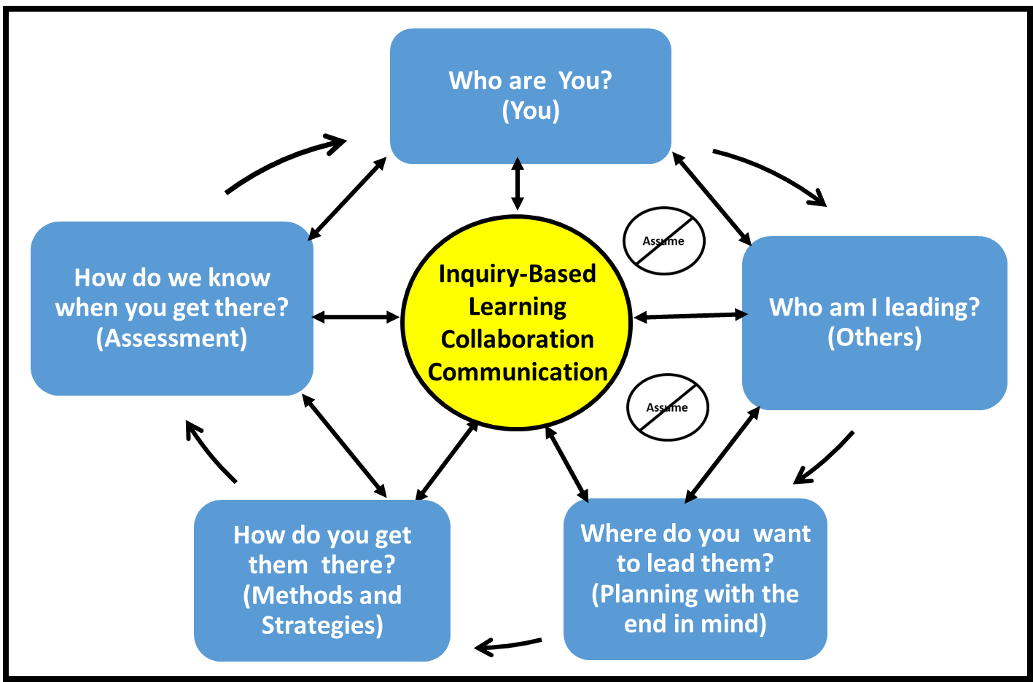
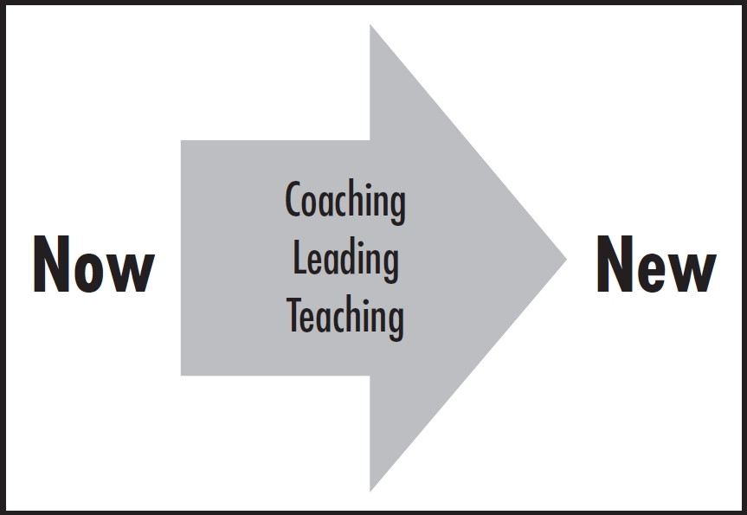
Framework: Collaborative Leadership Action Model (Gosselin 2015)
Notes:
A fundamental component to any collaboration or team are people. Gosselin (2015) in his book Focus on Them: Leading the Mindset Revolution for Coaches, Educators, and Business Leaders developed what is now referred to as a collaborative leadership action model. A basic premise of this model is that leading, coaching, and educating are all about taking individuals and organizations (i.e., people) from where they are now to someplace new. Fundamental to going from “now to new”, requires the creation of an environment where learning, collaboration, and communication are central themes. To create this type of environment, action needs to be taken on five framework questions highlighted in the blue boxes. Of these five questions, the “knowing who you are” (Click) and ”knowing who you are leading” (Click) are often overlooked or underemphasized as critical components to moving individuals, team or organizations forward. One of the overarching themes of this session is exploring who we are in the context of our experiences, knowledge, and ideas related to research.

Slide 4
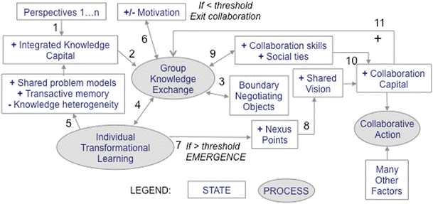
Framework: Conceptual Interaction Model
Pennington 2016
Notes:
Whether we realize it or not, we all have some type of framework or model for how a collaborative, interdisciplinary team functions. Our EMBeRS colleague, Deana Pennington in 2016 (See descriptions of the details of this diagram in the paper), presented a framework, which she refers to as a conceptual interaction model, that is at the foundation of the EMBeRS process. A key attribute to this model is that it recognizes that for any team process multiple perspectives (click) are brought into a project. Interdisciplinary and transdisciplinary research involves experts from a range of disciplinary and professional perspective who come together to form a team in order to integrate knowledge. Often, teams will face challenges that arise from differences in conceptual understanding of the problem that result from different approaches, methods, values, and assumptions related to the processes of research and investigation. Therefore, it is valuable to expose and articulate these differences early on in the project as well as addressing them periodically during the course of the project.

Slide 5
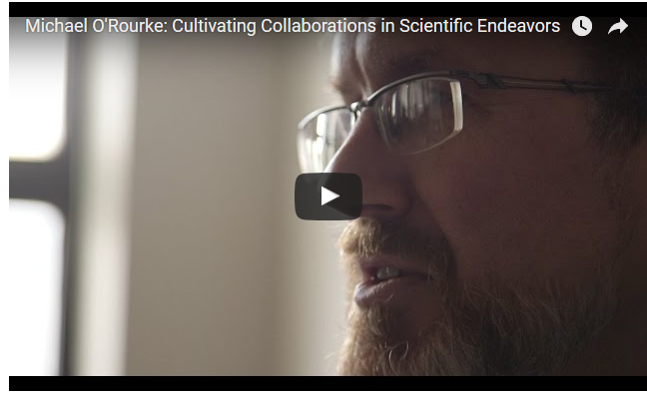
Introduction: Cultivating Collaborations in Scientific Endeavors – Michael O’Rourke
Build Off the Toolbox Model and Structured Dialog
Notes:
There is substantial research that indicates the creation of an environment where constructive and open dialog can occur to address research assumptions, among other things, will lead to positive outcomes. Michael O’Rourke and colleagues through their Toolbox Dialogue Initiative provide a practical approach that engages investigators in a structured dialogue about their research assumptions. Their approach increases self-awareness and mutual understanding that provides collaborators with an improved foundation for effective collaborative research and practice.
Note: Watch the short video clip from Michael O’Rourke. Click on image.
Click - Our plan is to use the O’Rourke and colleagues’ ToolBox approach to model structured dialogue as an approach to improving the environment for interdisciplinary collaboration.

Slide 6
Structured Dialogue
A means of discourse oriented toward problem understanding and consensual action.
A coordinated approach to explore multiple perspectives where participants agree to follow a framework or facilitation the enables groups to address complex shared problems.
Notes:
Structured dialogue represents a class of dialogue practices developed as a means of orienting the dialogic discourse toward problem understanding and consensual action. Whereas most traditional dialogue practices are unstructured or semi-structured, such conversational modes have been observed as insufficient for the coordination of multiple perspectives in a problem area. A disciplined form of dialogue, where participants agree to follow a framework or facilitation, enables groups to address complex shared problems. From: https://en.wikipedia.org/wiki/Dialogue#Structured_dialogue

Slide 7
Our Structured Approach
Complete a set of guiding questions to facilitate your thinking
Small Group Dialogue
Large Group Dialogue and Sharing
Co-Create in small groups (5 take-away messages on which to periodically reflect during the course of the workshop).
Debrief/co-creation share

Slide 8
Complete the Questionnaire (30 minutes)
Upon completion, place a checkmark on the whiteboard.

Slide 9
Small Group Dialogue (60 min)
Key Considerations (“Use talking stick”**)
Establish the group’s principles or guidelines on how you want to the group to function using the question, “What do we need from each other to engage in dialogue?”
Your objective: define jargon; share experiences, knowledge, and ideas related to the guiding questions; learn from one another; identify and explore your own assumptions; respectfully challenge each other assumptions
Everyone should be encouraged to share. All voices should “enter the room.” “Use serial testimony”* or “Mutual invitation”*
Create a list of similarities and differences in the way each of you have experienced research and answered the questions. How does your personal experience influence your dialog with others?
See ** notes and *session resources.
Modified from NPS Interpretive Development Program – Professional Standards for Learning and Performance
Notes:
Use Hands-off facilitation. Facilitator steps back and allows dialogue to continue (while staying responsible for keeping safety)
See Handouts: Arc of Dialogue and Facilitated Dialogue Techniques
* Talking stick enables all those present at a meeting to be heard. It is passed around from person to person allowing only the person holding the stick to speak. This enables all those present at a meeting to be heard, especially those who may be shy; group guidelines can force the stick to move along to assure that the "long winded" don't dominate the discussion. The person holding the stick may allow others to interject.

Slide 10
Large Group Debrief (30 min)
Objectives (“Use talking stick”**)
Share ideas, perspectives and insights generated through the dialogue.
Identify and explore your own assumptions.
Respectfully challenge each other assumptions
See ** notes and *session resources.
Modified from NPS Interpretive Development Program – Professional Standards for Learning and Performance
Notes:
Use Hands-off facilitation: Facilitator steps back and allows dialogue to continue (while staying responsible for keeping safety)
See Handouts: Arc of Dialogue and Facilitated Dialogue Techniques
*Talking stick enables all those present at a meeting to be heard. It is passed around from person to person allowing only the person holding the stick to speak. This enables all those present at a meeting to be heard, especially those who may be shy; group guidelines can force the stick to move along to assure that the "long winded" don't dominate the discussion. The person holding the stick may allow others to interject.

Slide 11
Small Group Dialogue (20 min)
Objective (“Use talking stick”**)
Co-Create five take-away message to reflect on over the course of the workshop. (What are five ideas or insights that you will take away from today’s experiences and need to be reflected on over the course of the workshop??
Record messages on large paper
Post around the room.
See ** notes and *session resources.
Modified from NPS Interpretive Development Program – Professional Standards for Learning and Performance
Notes:
Use Hands-off facilitation. Facilitator steps back and allows dialogue to continue (while staying responsible for keeping safety)
See Handouts: Arc of Dialogue and Facilitated Dialogue Techniques
* Talking stick enables all those present at a meeting to be heard. It is passed around from person to person allowing only the person holding the stick to speak. This enables all those present at a meeting to be heard, especially those who may be shy; group guidelines can force the stick to move along to assure that the "long winded" don't dominate the discussion. The person holding the stick may allow others to interject.

Slide 12
Post - Session Reflection (15 min)
What are two ideas or insights that you will take away from this experience?
If you could continue to replicate this conversation with anyone in your life, who would that be and why?
What, if anything, did you hear in this conversation that challenged your assumptions? What, if anything, did you hear that confirmed your assumptions? Tell us about how your assumptions were challenged.
What impact, if any, will this dialogue experience have on the way you perceive or interact with your colleagues at your home institution?

